Slide 1
React-Redux
Redux concepts
Example application
Understanding the example application

Slide 2
Section 1: Redux Concepts
Overview
Organizing state into slices
Identifying actions
Defining reducer functions
How it all fits together

Slide 3
Overview
Redux helps you manage state in an application
Redux has a store
Holds all the state for your application, globally
Redux has action objects
Specify a change you want to make to the state
Redux has reducer functions
Receives current state and action, updates state accordingly
3

Slide 4
Organizing State into Slices
Redux stores your application state in slices
Redux Store
products
customers
orders
4

Slide 5
Identifying Actions
For each slice of state:
Think about what actions can happen in the system, to cause that slice of state to be updated
E.g. actions for the products slice:
Add a product, like a product, remove a product
To cause an update:
You create an action object, describing a desired state change
You dispatch the action object to the Redux Store
5

Slide 6
Defining Reducer Functions
Actions are carried out by reducer functions
You define a separate reducer function for each slice of state
A reducer function receives 2 parameters:
The current slice of state (e.g. products)
An action object, indicating the change required
A reducer function updates the state, as instructed by the action object
6

Slide 7
How it all Fits Together
Redux Store
addProduct
action object
products
products reducer function
Receives 2 parameters:
Current products state
An action object
Updates products state, based on the action object
likeProduct
action object
removeProduct
action object
customers
Dispatch an action object to Redux Store
Redux calls the reducer function to update the state accordingly
orders
7

Slide 8
Section 2: Example Application
Overview
Viewing and updating the counter state slice
Viewing and updating the products state slice

Slide 9
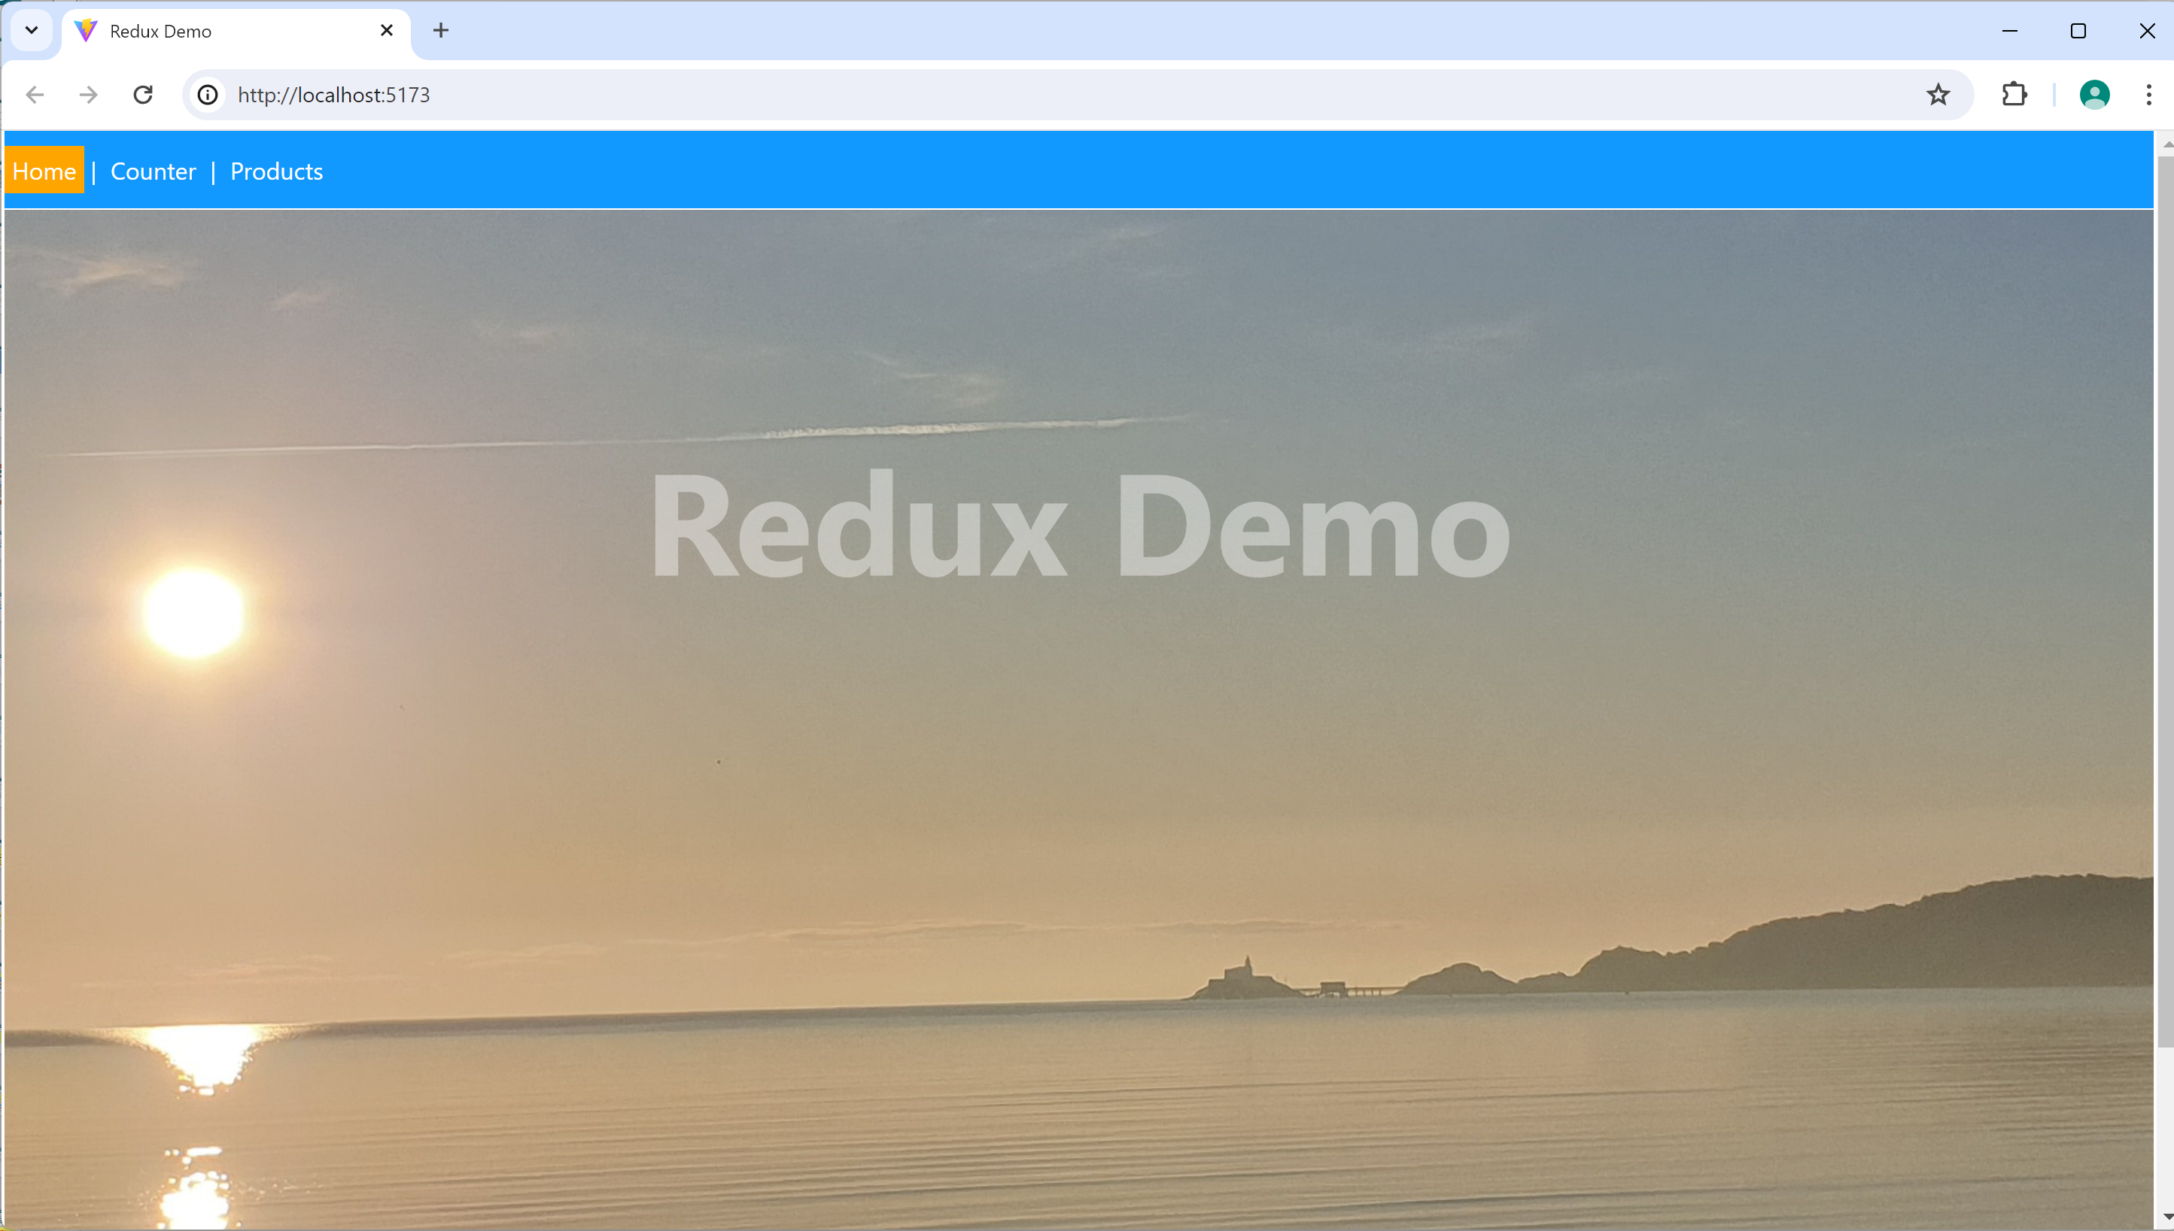
Overview
In the demo-app folder, run and
The application has 2 slices of state:
counter
products
npm install
npm run dev
9

Slide 10
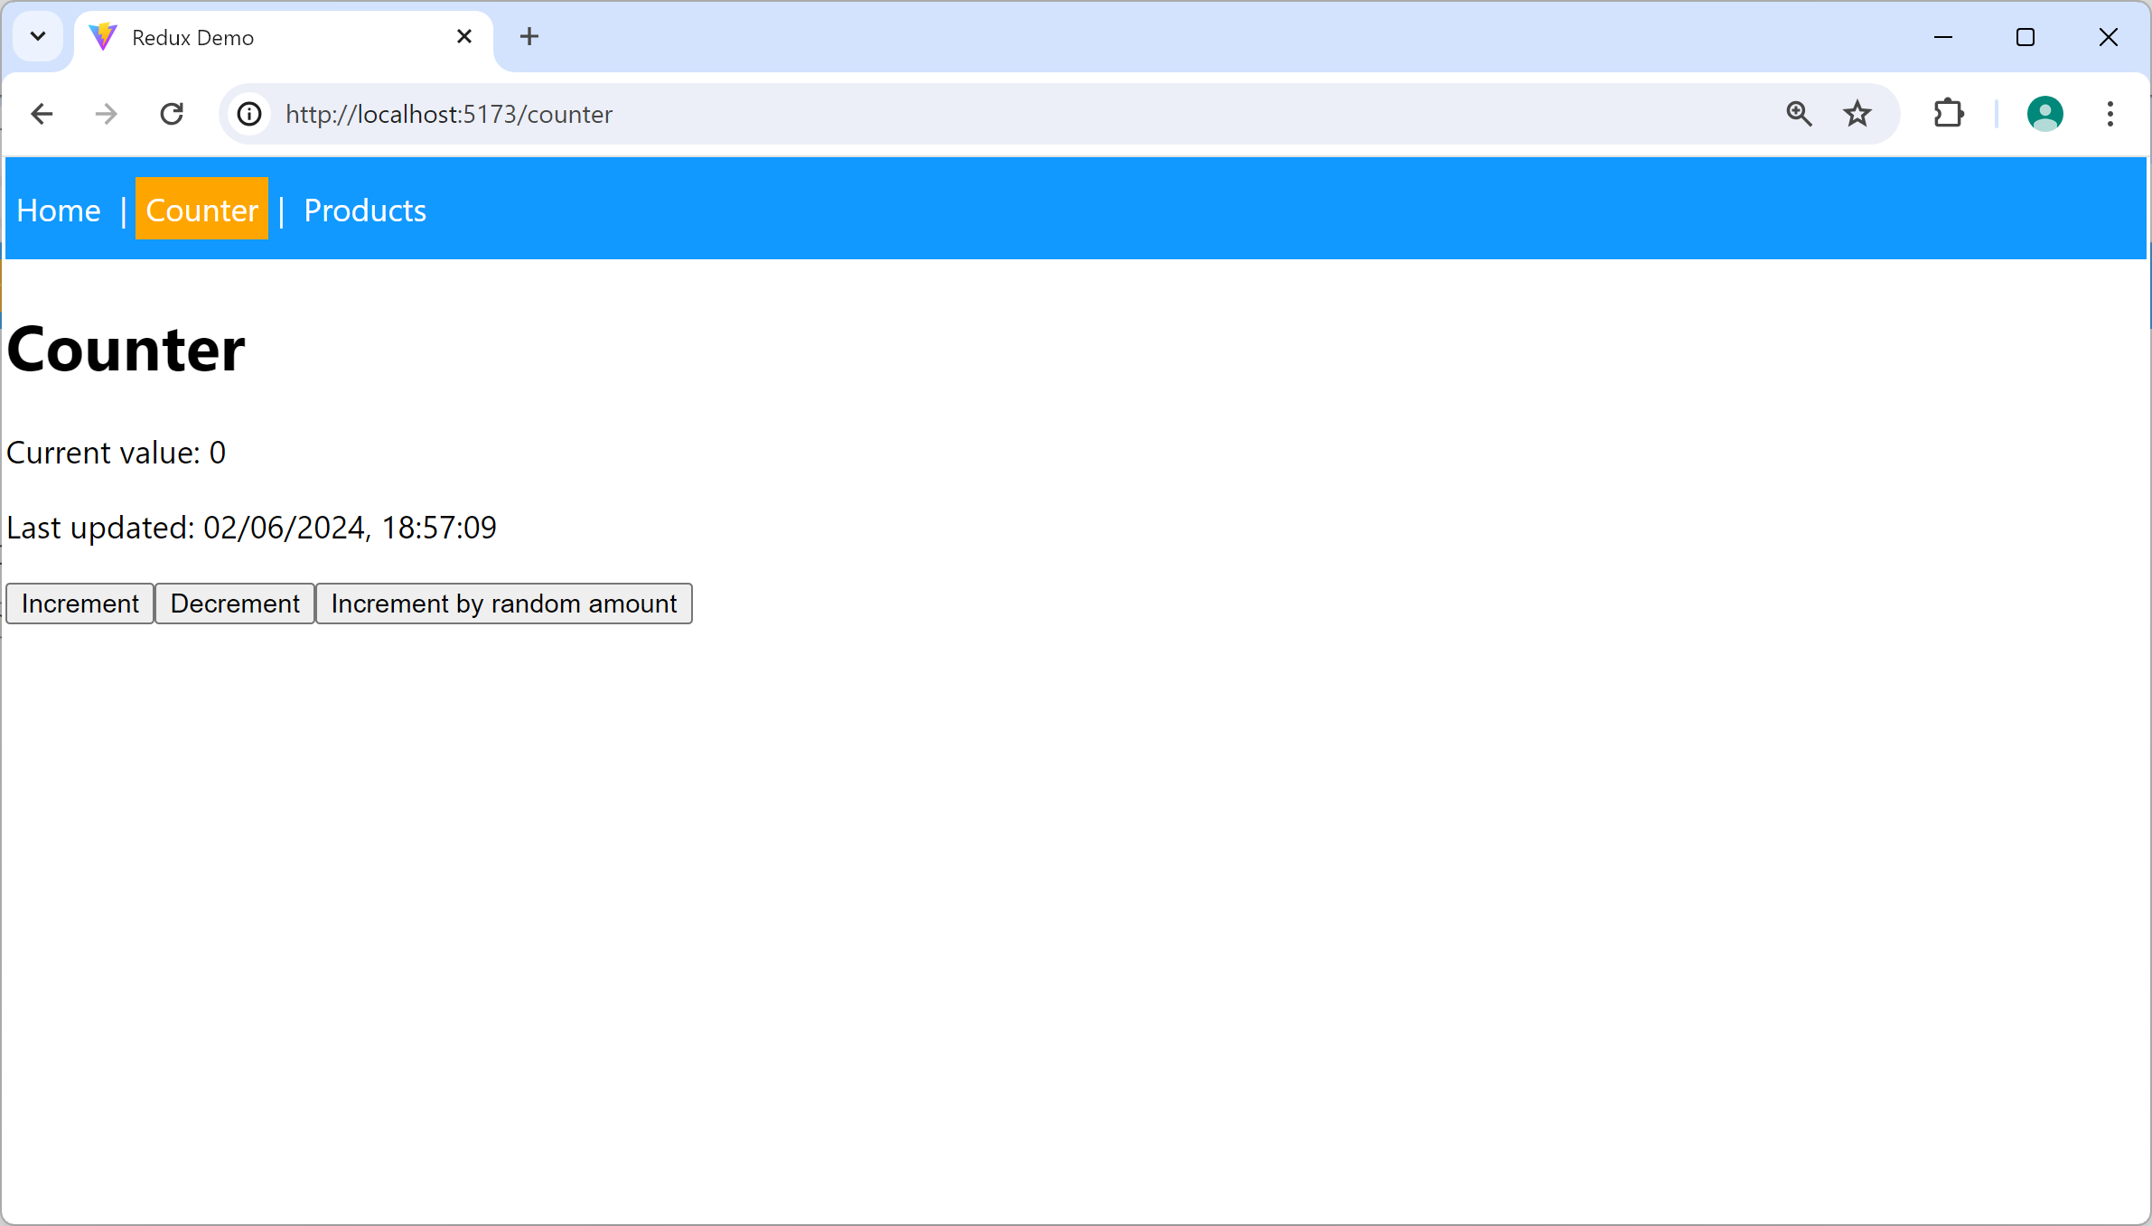
Viewing and Updating the counter State Slice
Click the Counter menu item
Renders the Counter.tsx component
Views and updates the counter state slice
10

Slide 11
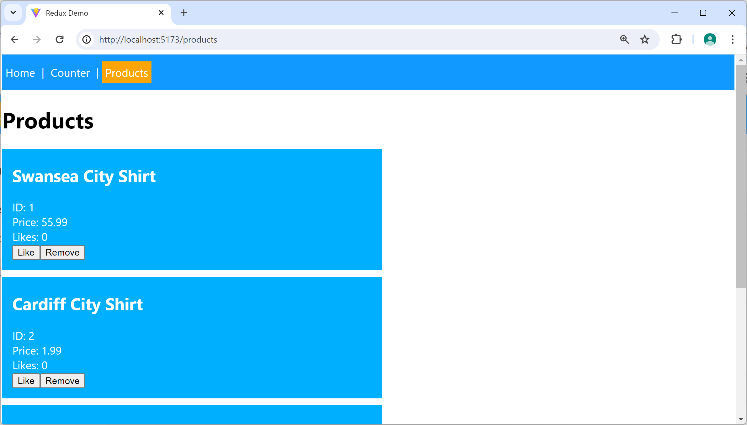
Viewing and Updating the products State Slice
Click the Products menu item
Renders the Products.tsx component
Views and updates the products state slice
11

Slide 12
Section 3: Understanding the Example Application
Dependencies for React Redux
Creating slices
Configuring the Redux Store
Providing state to all components
Accessing state in a component
Creating and dispatching actions
Understanding the products slice

Slide 13
Dependencies for React Redux
To use React Redux, add the following dependencies in your package.json file:
Note:
Redux Toolkit (RTK) is optional, but strongly recommended
Simplifies many aspects of React Redux development
"dependencies": {
"react-redux": "^8.0.2",
"@reduxjs/toolkit": "^1.8.3",
…
},
"devDependencies": {
"@types/react-redux": "^7.1.24",
…
}
package.json
13

Slide 14
Creating Slices (1 of 3)
RTK has a createSlice() function
Creates a slice of state for your application
The slice contains initial state, actions, and reducer logic
We create 2 slices of state in our app, see:
counterSlice.ts - We'll discuss this first
productsSlice.ts - We'll discuss this later
14

Slide 15
Creating Slices (2 of 3)
Here's how we create the counter slice:
import { createSlice } from '@reduxjs/toolkit'
const counterSlice = createSlice({
name: 'counter',
initialState: { value: 0, lastUpdated: new Date().toLocaleString()},
reducers: {
increment: (state) => {
// Case-reducer for 'increment' action, increments value by 1.
},
decrement: (state) => {
// Case-reducer for 'decrement' action, decrements value by 1.
},
incrementByAmount: (state, action) => {
// Case-reducer for 'incrementByAmount' action, increments value by amount.
}
}
})
case-reducer functions
counterSlice.ts
15

Slide 16
Creating Slices (3 of 3)
RTK combines our case-reducer functions into a single reducer function, like so:
const counterSlice = createSlice({
name: 'counter',
initialState: {…},
reducers: {
increment: (state) => {…},
decrement: (state) => {…},
incrementByAmount: (state, action) => {…}
}
})
counterSlice.reducer(state, action) {
switch (action.type) {
case 'counter/increment':
increment(state)
break
case 'counter/decrement':
decrement(state)
break
case 'counter/incrementByAmount':
incrementByAmount(state, action)
break
}
}
16

Slide 17
Configuring the Redux Store
Once you've created your slices, the next step is to configure the Redux Store to house these slices
import { configureStore } from '@reduxjs/toolkit'
import counterSlice from './counterSlice'
import productsSlice from './productsSlice'
const store = configureStore({
reducer: {
counter: counterSlice.reducer,
products: productsSlice.reducer
}
})
Redux Store
main.tsx
counter
products
17

Slide 18
Providing State to all Components
Redux makes it easy to provide state to all components:
import { Provider } from 'react-redux'
…
ReactDOM.createRoot(document.getElementById('root')!).render(
<React.StrictMode>
<Provider store={store}>
<App />
</Provider>
</React.StrictMode>,
)
main.tsx
18

Slide 19
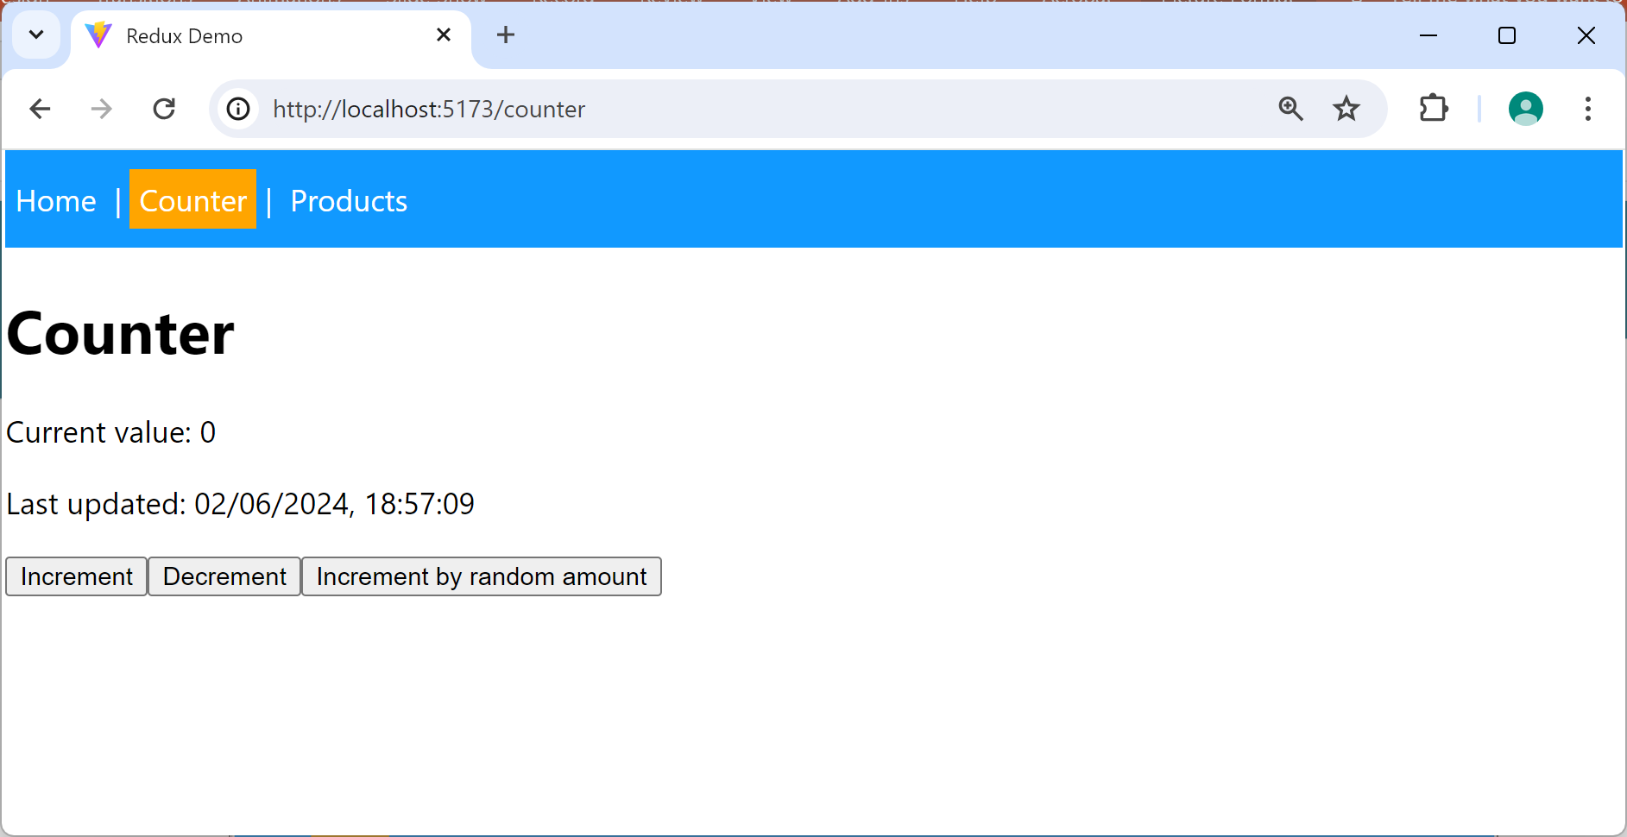
Accessing State in a Component
A component can access Redux Store state as follows:
Counter.tsx
import { useSelector } from 'react-redux'
…
export default function Counter() {
const counter: any = useSelector((store: any) => store.counter)
return (
<div>
<div>
<h1>Counter</h1>
<p>Current value: {counter.value}</p>
<p>Last updated: {counter.lastUpdated}</p>
…
</div>
</div>
)
}
19

Slide 20
Creating and Dispatching Actions (1 of 3)
When you want to update state in a slice:
Create an action object
Dispatch the action object to Redux Store
(Redux Store invokes a reducer function, to do the work)
Let's see how to do this…
20

Slide 21
Creating and Dispatching Actions (2 of 3)
RTK generates action-creator functions for your slice
counterSlice.actions.increment()
counterSlice.actions.decrement()
counterSlice.actions.incrementByAmount()
These functions create action objects for you:
import counterSlice from './counterSlice'
…
const num = Math.round(Math.random() * 10)
const anActionObject = counterSlice.actions.incrementByAmount(num)
an action object
{
type: 'counter/incrementByAmount',
payload: num
}
21

Slide 22
Creating and Dispatching Actions (3 of 3)
To dispatch an action object to Redux Store:
For a complete example
See Counter.tsx
import { useDispatch } from 'react-redux'
…
export default function Counter() {
const dispatch = useDispatch()
…
dispatch(anActionObject)
…
}
Counter.tsx
22

Slide 23
Understanding the products Slice
We've seen how the counter slice works
counterSlice.ts - Creates counter slice
Counter.tsx - Views and updates counter slice
Now let's see how the products slice works
productsSlice.ts - Creates products slice
Products.tsx - Views and updates products slice
23

Slide 24
Summary
Redux concepts
Example application
Understanding the example application

